Slide 1
Block diagram of combinational circuit
Combinational Circuit
Inputs
Outputs

Slide 2
Block diagram of sequential circuit
Combinational Circuit
Inputs
Outputs
Memory Elements

Slide 3
Describe the fundamental difference between the output of a combinational circuit and the output of a sequential circuit.
Answer: The output of a combinational circuit depends on only the inputs to the circuit; the output of a sequential circuit depends on the inputs to the circuit and the present state of the storage elements.

Slide 4
Combinational Circuit
Inputs
Outputs
Memory Elements
  (inputs, current state) ◊ (outputs, next state)

Slide 5
A (circuit) state is the combination of 0s and 1s of the memory elements. In a sequential circuit with M memory elements, there are 2^{M} states.
Past input accumulation becomes the current circuit state

Slide 6
Combinational Circuit
Inputs
Outputs
Flip-Flops
In a sequential circuit, memory elements are called Flip-Flops.

Slide 7
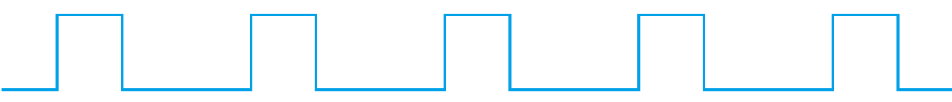
Combinational Circuit
Inputs
Outputs
Flip-Flops

Slide 8
SR-Latch (with NAND gates)
SR-Latch (with NOR gates)
D-Latch
Flip-Flop
D Flip-Flop
J-K Flip-Flop
T Flip-Flop

Slide 9
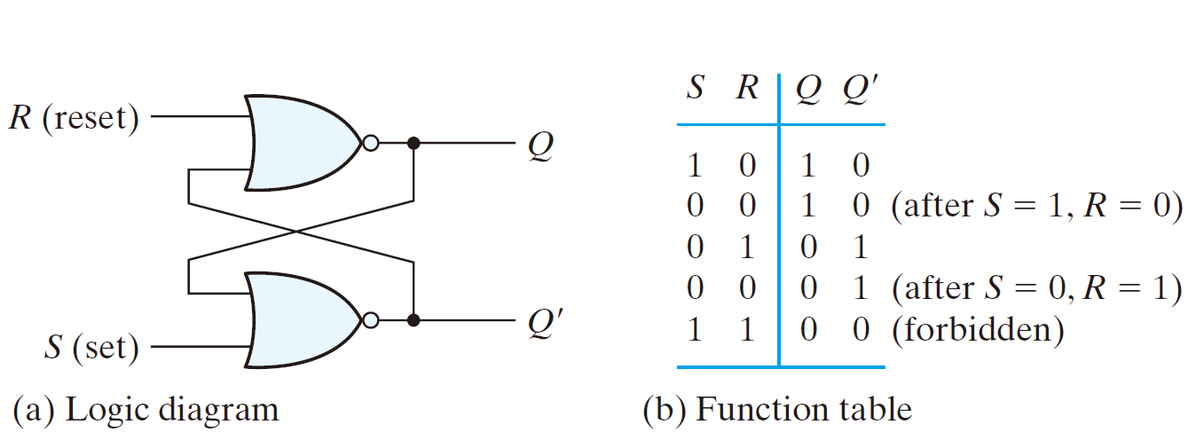
SR latch with NOR gates

Slide 10
SR latch with NOR gates
0
1

Slide 11
SR latch with NOR gates
0
1
0

Slide 12
SR latch with NOR gates
1
0
1
0

Slide 13
SR latch with NOR gates
1
0
0
0

Slide 14
SR latch with NOR gates
1
0

Slide 15
SR latch with NOR gates
0
1
0

Slide 16
SR latch with NOR gates
0
1
0
1

Slide 17
SR latch with NOR gates
0
0
0
1

Slide 18
SR latch with NOR gates
0
1
X
1
0

Slide 19
  (S,R) = (0, 0): no operation
  (S,R) = (0, 1): reset (Q = 0, the clear state)
  (S,R) = (1, 0): set (Q = 1, the set state)
  (S,R) = (1, 1): indeterminate state (Q = Q‘ = 0)

Slide 20
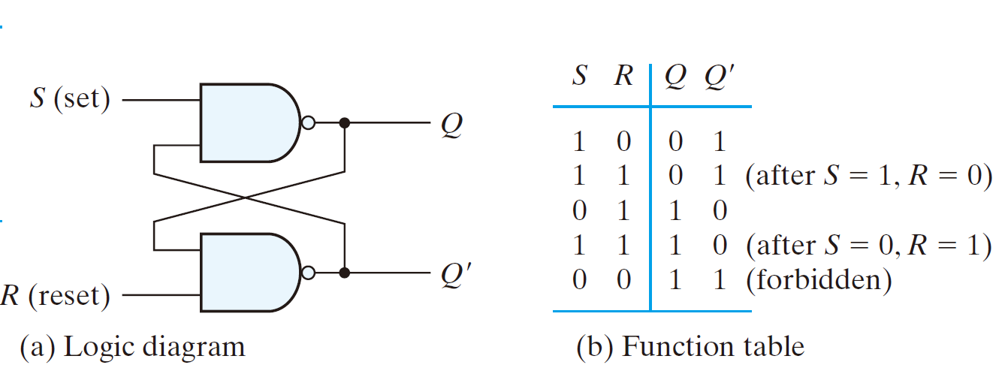
SR latch with NAND gates

Slide 21
SR latch with NAND gates
1
0

Slide 22
SR latch with NAND gates
1
0
1

Slide 23
SR latch with NAND gates
0
1
0
1

Slide 24
SR latch with NAND gates
0
1
1
1

Slide 25
SR latch with NAND gates
0
1

Slide 26
SR latch with NAND gates
1
0
1

Slide 27
SR latch with NAND gates
1
0
1
0

Slide 28
SR latch with NAND gates
1
1
1
0

Slide 29
SR latch with NAND gates
1
0
X
0
1

Slide 30
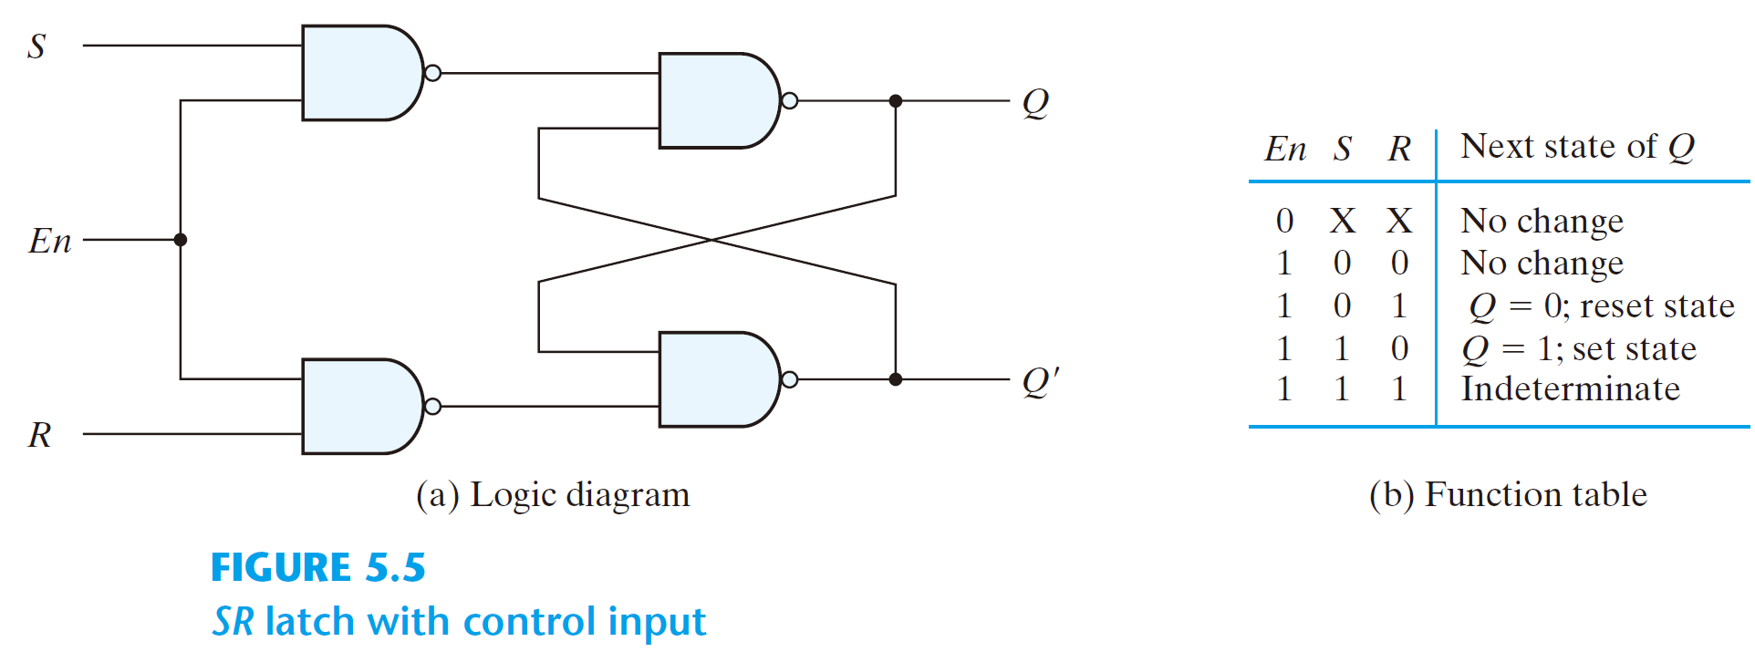
SR latch with control input
  En = 0, no change
  En = 1,
SR latch

Slide 31
SR latch with control input
  En = 0, no change
  En = 1,
SR latch
0

Slide 32
SR latch with control input
  En = 0, no change
  En = 1,
1
SR latch
0
1

Slide 33
SR latch with control input
  En = 0, no change
  En = 1,
1
SR latch
0
1
Q’

Slide 34
SR latch with control input
  En = 0, no change
  En = 1,
1
SR latch
Q
0
1
Q’

Slide 35
SR latch with control input
  En = 0, no change
  En = 1,
SR latch
1
1
0

Slide 36
SR latch with control input
  En = 0, no change
  En = 1,
0
SR latch
1
1
0
1

Slide 37
SR latch with control input
  En = 0, no change
  En = 1,
0
SR latch
1
1
1
0
1

Slide 38
SR latch with control input
  En = 0, no change
  En = 1,
0
SR latch
1
1
1
0
1
0

Slide 39
SR latch with control input
  En = 0, no change
  En = 1,
SR latch
0
1
1

Slide 40
SR latch with control input
  En = 0, no change
  En = 1,
1
SR latch
0
1
1
0

Slide 41
SR latch with control input
  En = 0, no change
  En = 1,
1
SR latch
0
1
1
0
1

Slide 42
SR latch with control input
  En = 0, no change
  En = 1,
1
SR latch
0
0
1
1
0
1

Slide 43
SR latch with control input
  En = 0, no change
  En = 1,
SR latch
0
1
0

Slide 44
SR latch with control input
  En = 0, no change
  En = 1,
1
SR latch
0
1
0
1

Slide 45
SR latch with control input
  En = 0, no change
  En = 1,
1
SR latch
0
1
0
1
Q’

Slide 46
SR latch with control input
  En = 0, no change
  En = 1,
1
SR latch
Q
0
1
0
1
Q’

Slide 47
SR latch with control input
  En = 0, no change
  En = 1,
SR latch
1
1
1

Slide 48
SR latch with control input
  En = 0, no change
  En = 1,
0
SR latch
1
1
1
0

Slide 49
SR latch with control input
  En = 0, no change
  En = 1,
0
SR latch
1
1
1
1
0

Slide 50
SR latch with control input
  En = 0, no change
  En = 1,
0
SR latch
1
1
1
1
0
1

Slide 51
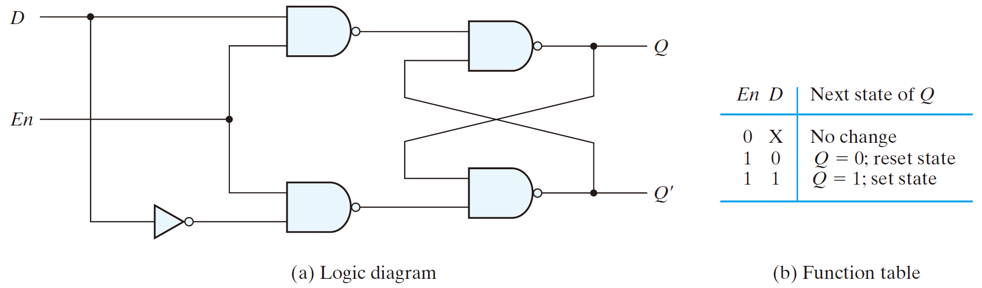
D Latch (Transparent Latch)

Slide 52
D Latch (Transparent Latch)
0

Slide 53
D Latch (Transparent Latch)
1
0
1

Slide 54
D Latch (Transparent Latch)
1
0
1
Q’

Slide 55
D Latch (Transparent Latch)
1
Q
0
1
Q’

Slide 56
D Latch (Transparent Latch)
0
1

Slide 57
D Latch (Transparent Latch)
0
1
1
0

Slide 58
D Latch (Transparent Latch)
0
1
1
1
0

Slide 59
D Latch (Transparent Latch)
0
1
0
1
1
0

Slide 60
D Latch (Transparent Latch)
1
1

Slide 61
D Latch (Transparent Latch)
1
0
1
1

Slide 62
D Latch (Transparent Latch)
1
0
1
1
1

Slide 63
D Latch (Transparent Latch)
1
0
1
1
1
0

Slide 64
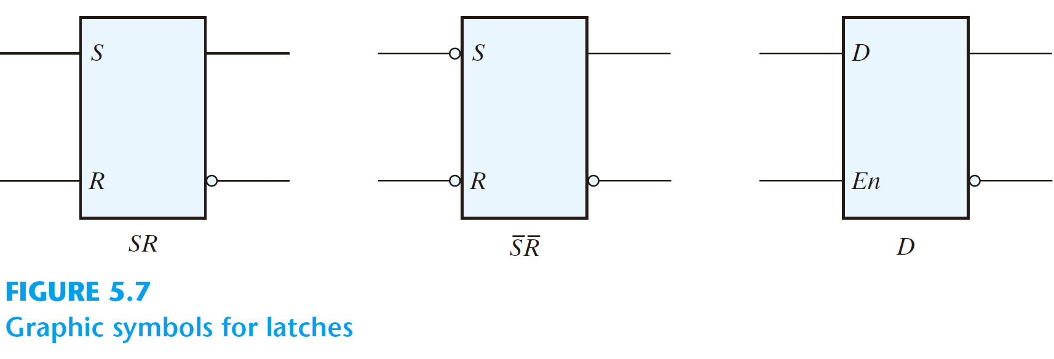
Graphic symbols

Slide 65
D Latch (Transparent Latch)
A transparent latch has a data input, an enable input, and output. When the enable input is asserted, the output of the latch follows the input to the latch. When the enable input is de-asserted, the output of the latch is held at the value that was present at the moment the enable input was de-asserted.
Q

Slide 66
Clock
Q
Data
Q
Q’
Timing diagram D-latch

Slide 67
Clock
Q
Data
Q
Q’
Timing diagram D-latch

Slide 68
Clock
Q
Data
Q
Q’
Timing diagram D-latch

Slide 69
Clock
Q
Data
Q
Q’
Timing diagram D-latch

Slide 70
Clock
Q
Data
Q
Q’
Timing diagram D-latch

Slide 71
Clock
Q
Data
Q
Q’
Timing diagram D-latch

Slide 72
Clock
Q
Data
Q
Q’
Timing diagram D-latch

Slide 73
Clock
Q
Data
Q
Q’
Timing diagram D-latch

Slide 74
Clock
Q
Data
Q
Q’
Timing diagram D-latch

Slide 75
Clock
Q
Data
Q
Q’
Timing diagram D-latch

Slide 76
Clock
Q
Data
Q
Q’
Timing diagram D-latch

Slide 77
Clock
Q
Data
Q
Q’
Timing diagram D-latch

Slide 78
Clock
Q
Data
Q
Q’
Timing diagram D-latch

Slide 79
Clock
Q
Data
Q
Q’
Timing diagram D-latch

Slide 81
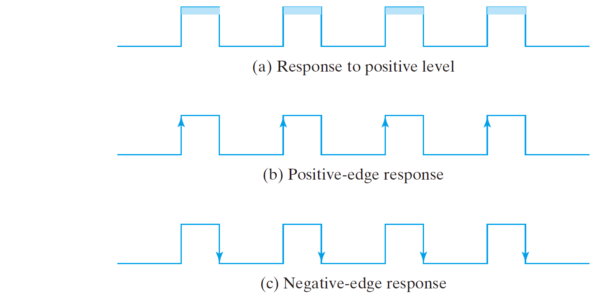
A trigger
  The state of a latch or flip-flop is switched by a change of the control input
Level triggered – latches
Edge triggered – flip-flops

Slide 82
Edge-triggered flip-flops
  the state transition happens only at the edge
  eliminate the multiple-transition problem

Slide 83
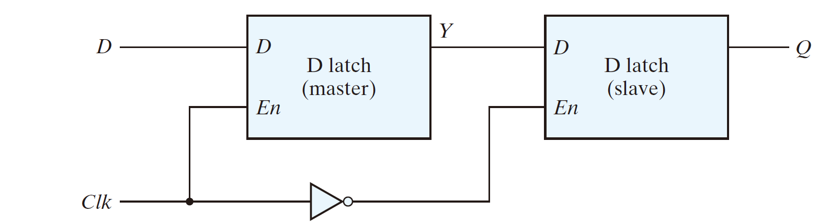
Edge-triggered D flip-flop (Master-slave D flip-flop)

Slide 84
Clock
Data
Y
Q

Slide 85
Clock
Data
Y
Q

Slide 86
Clock
Data
Y
Q

Slide 87
Clock
Data
Y
Q

Slide 88
Clock
Data
Y
Q

Slide 89
Clock
Data
Y
Q

Slide 90
Clock
Data
Y
Q

Slide 91
Clock
Data
Y
Q

Slide 92
Clock
Data
Y
Q

Slide 93
Clock
Data
Y
Q

Slide 94
Clock
Data
Y
Q

Slide 95
Clock
Data
Y
Q

Slide 96
Clock
Data
Y
Q

Slide 97
Clock
Data
Y
Q

Slide 98
Clock
Data
Y
Q

Slide 99
Clock
Data
Y
Q

Slide 100
Clock
Data
Y
Q

Slide 101
Clock
Data
Y
Q

Slide 102
Clock
Data
Y
Q

Slide 103
Clock
Data
Y
Q

Slide 104
Clock
Data
Y
Q

Slide 105
Clock
Data
Y
Q

Slide 106
Clock
Data
Y
Q

Slide 107
Clock
Data
Y
Q

Slide 108
Clock
Data
Y
Q

Slide 109
Clock
Data
Y
Q
Negative-Edge-triggered D flip-flop

Slide 110
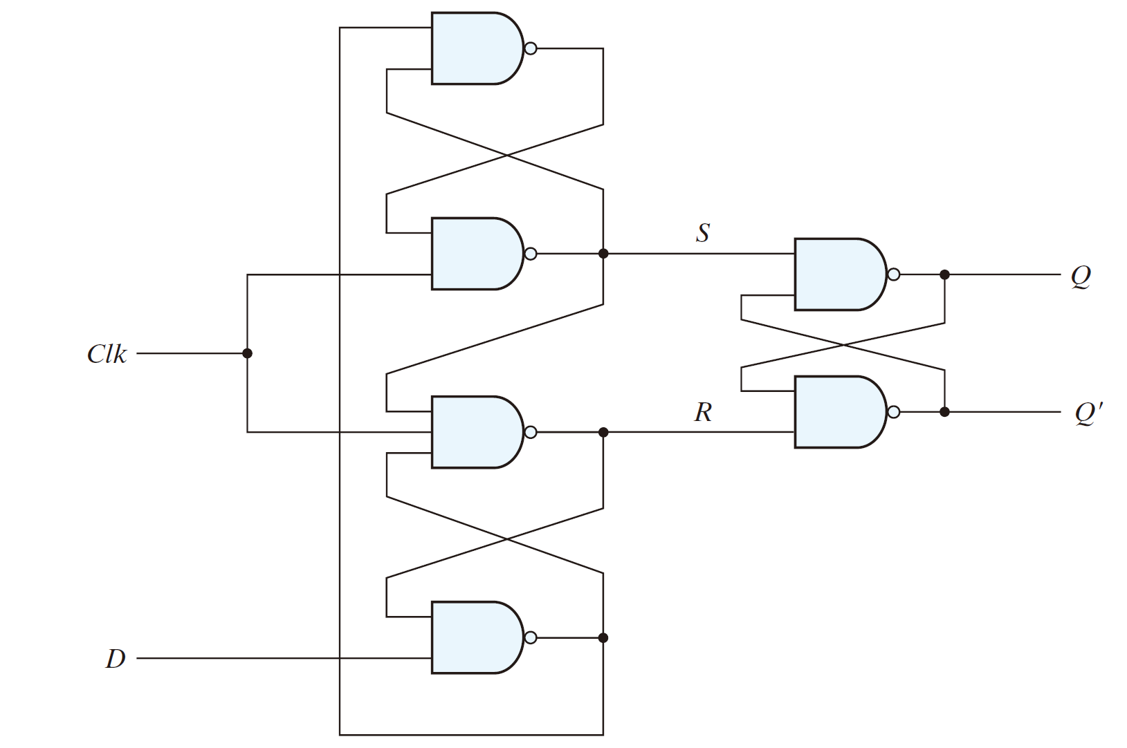
A D-type positive-edge-triggered flip-flop

Slide 111
A D-type positive-edge-triggered flip-flop

Slide 112
A D-type positive-edge-triggered flip-flop
ClK
D
Q

Slide 113
A D-type positive-edge-triggered flip-flop
0
0
0
ClK
D
0
Q

Slide 114
A D-type positive-edge-triggered flip-flop
0
0
1
0
ClK
D
1
0
Q

Slide 115
A D-type positive-edge-triggered flip-flop
0
0
1
0
ClK
1
D
1
0
Q

Slide 116
A D-type positive-edge-triggered flip-flop
0
0
1
0
ClK
1
D
1
0
Q

Slide 117
A D-type positive-edge-triggered flip-flop
0
0
1
1
1
ClK
1
D
1
0
Q
1

Slide 118
A D-type positive-edge-triggered flip-flop
0
0
1
1
1
ClK
1
D
1
0
Q
1
0

Slide 119
A D-type positive-edge-triggered flip-flop
1
0
0
1
1
1
ClK
1
D
1
0
Q
1
0

Slide 120
A D-type positive-edge-triggered flip-flop
1
0
0
1
0
1
ClK
1
D
1
0
Q
1
0

Slide 121
A D-type positive-edge-triggered flip-flop
1
1
0
1
0
1
ClK
1
D
1
0
Q
1
0

Slide 122
A D-type positive-edge-triggered flip-flop
1
1
0
1
0
1
ClK
0
D
1
0
Q
1
0

Slide 123
A D-type positive-edge-triggered flip-flop
1
1
0
1
0
1
ClK
0
D
1
0
Q
1
0

Slide 124
A D-type positive-edge-triggered flip-flop
1
1
0
1
0
1
ClK
0
D
1
0
Q
0
0

Slide 125
A D-type positive-edge-triggered flip-flop
1
1
0
1
0
1
ClK
0
D
1
0
Q
0
1

Slide 126
A D-type positive-edge-triggered flip-flop
1
1
0
1
0
1
ClK
0
D
1
0
Q
0
1

Slide 127
A D-type positive-edge-triggered flip-flop
1
1
0
1
0
1
ClK
0
D
1
0
Q
0
1

Slide 128
A D-type positive-edge-triggered flip-flop
1
1
0
1
0
0
0
ClK
0
D
1
0
Q
0
1

Slide 129
A D-type positive-edge-triggered flip-flop
1
1
0
1
0
1
0
ClK
0
D
1
0
Q
0
1

Slide 130
A D-type positive-edge-triggered flip-flop
1
1
0
1
0
1
0
ClK
0
D
1
0
Q
0
1

Slide 131
A D-type positive-edge-triggered flip-flop
1
1
0
1
0
1
0
ClK
0
D
1
0
Q
0
1

Slide 132
A D-type positive-edge-triggered flip-flop
1
1
0
1
0
1
0
ClK
0
D
1
0
Q
0
1

Slide 133
A D-type positive-edge-triggered flip-flop
1
1
0
1
0
1
1
1
ClK
0
D
1
0
Q
0
1

Slide 134
A D-type positive-edge-triggered flip-flop
1
1
0
1
0
1
1
1
ClK
0
D
0
0
Q
0
1

Slide 135
A D-type positive-edge-triggered flip-flop
1
1
0
1
0
1
1
1
ClK
1
D
0
0
Q
0
1

Slide 136
A D-type positive-edge-triggered flip-flop
0
1
0
1
0
1
1
1
ClK
1
D
0
0
Q
0
1

Slide 137
A D-type positive-edge-triggered flip-flop
0
1
0
1
0
1
1
1
ClK
1
D
0
0
Q
0
1

Slide 138
A D-type positive-edge-triggered flip-flop
0
1
0
1
0
1
1
1
ClK
1
D
0
0
Q
0
1

Slide 139
A D-type positive-edge-triggered flip-flop
0
0
0
1
0
1
1
1
ClK
1
D
0
0
Q
0
1

Slide 140
A D-type positive-edge-triggered flip-flop
0
0
0
1
0
1
1
1
ClK
1
D
0
0
Q
0
1

Slide 141
A D-type positive-edge-triggered flip-flop
0
0
0
1
0
1
1
0
0
ClK
1
D
0
0
Q
1
1

Slide 142
A D-type positive-edge-triggered flip-flop
0
0
0
1
0
1
1
0
0
ClK
1
D
1
0
Q
1
1

Slide 143
A D-type positive-edge-triggered flip-flop
0
0
0
1
0
1
1
0
0
ClK
1
D
1
0
Q
1
0

Slide 144
A D-type positive-edge-triggered flip-flop
1
0
0
1
0
1
1
0
0
ClK
1
D
1
0
Q
1
0

Slide 145
A D-type positive-edge-triggered flip-flop
1
0
0
1
0
1
1
0
0
ClK
1
D
1
0
Q
1
0

Slide 146
A D-type positive-edge-triggered flip-flop
1
0
0
1
0
1
1
0
0
ClK
1
D
1
0
Q
1
0

Slide 147
A D-type positive-edge-triggered flip-flop
Summary
  CP=0: (S,R) = (1,1), no state change
  CP=↑: state change once
  CP=1: state holds
0
1
0
1
0
ClK
D
0
Q

Slide 148
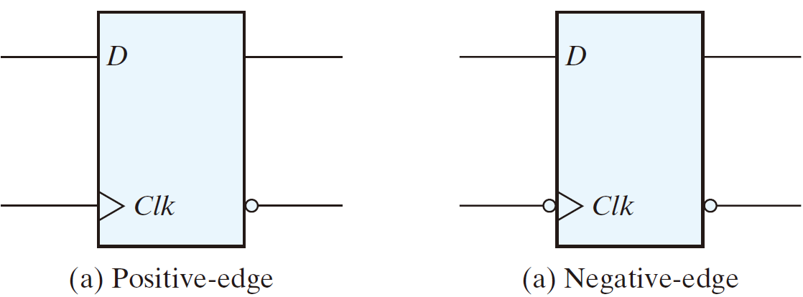
The edge-triggered D flip-flops
  The most economical and efficient
  Positive-edge and negative-edge

Slide 149
SR-Latch (with NAND gates)
SR-Latch (with NOR gates)
D-Latch
Flip-Flop
D Flip-Flop
J-K Flip-Flop
T Flip-Flop

Slide 150
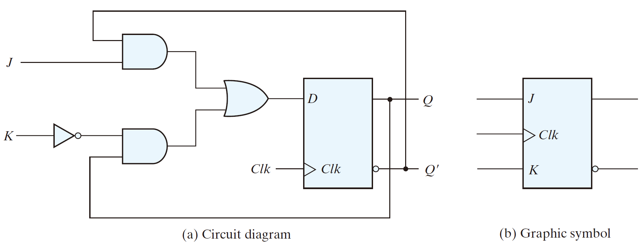
JK flip-flop
  D = JQ‘ + K’Q
    J = 0, K = 0: D = Q, no change
    J = 0, K = 1: D = 0 → Q = 0
    J = 1, K = 0: D = 1 → Q = 1
    J = 1, K = 1: D = Q’ → Q = Q’

Slide 151
JK flip-flop
0
0
Q
1
Q
0
  D = JQ‘ + K’Q
    J = 0, K = 0: D = Q, no change
    J = 0, K = 1: D = 0 → Q = 0
    J = 1, K = 0: D = 1 → Q = 1
    J = 1, K = 1: D = Q’ → Q = Q’

Slide 152
JK flip-flop
0
0
Q
Q
1
Q
0
  D = JQ‘ + K’Q
    J = 0, K = 0: D = Q, no change
    J = 0, K = 1: D = 0 → Q = 0
    J = 1, K = 0: D = 1 → Q = 1
    J = 1, K = 1: D = Q’ → Q = Q’

Slide 153
JK flip-flop
0
0
0
0
0
1
  D = JQ‘ + K’Q
    J = 0, K = 0: D = Q, no change
    J = 0, K = 1: D = 0 → Q = 0
    J = 1, K = 0: D = 1 → Q = 1
    J = 1, K = 1: D = Q’ → Q = Q’

Slide 154
JK flip-flop
0
0
0
0
0
0
1
  D = JQ‘ + K’Q
    J = 0, K = 0: D = Q, no change
    J = 0, K = 1: D = 0 → Q = 0
    J = 1, K = 0: D = 1 → Q = 1
    J = 1, K = 1: D = Q’ → Q = Q’

Slide 155
JK flip-flop
Q’
1
1
Q
0
  D = JQ‘ + K’Q
    J = 0, K = 0: D = Q, no change
    J = 0, K = 1: D = 0 → Q = 0
    J = 1, K = 0: D = 1 → Q = 1
    J = 1, K = 1: D = Q’ → Q = Q’

Slide 156
JK flip-flop
Q’
1
1
1
Q
0
  D = JQ‘ + K’Q
    J = 0, K = 0: D = Q, no change
    J = 0, K = 1: D = 0 → Q = 0
    J = 1, K = 0: D = 1 → Q = 1
    J = 1, K = 1: D = Q’ → Q = Q’

Slide 157
JK flip-flop
Q’
1
1
1
1
Q
0
  D = JQ‘ + K’Q
    J = 0, K = 0: D = Q, no change
    J = 0, K = 1: D = 0 → Q = 0
    J = 1, K = 0: D = 1 → Q = 1
    J = 1, K = 1: D = Q’ → Q = Q’

Slide 158
JK flip-flop
Q’
1
0
0
1
  D = JQ‘ + K’Q
    J = 0, K = 0: D = Q, no change
    J = 0, K = 1: D = 0 → Q = 0
    J = 1, K = 0: D = 1 → Q = 1
    J = 1, K = 1: D = Q’ → Q = Q’

Slide 159
JK flip-flop
Q’
1
Q’
0
0
1
  D = JQ‘ + K’Q
    J = 0, K = 0: D = Q, no change
    J = 0, K = 1: D = 0 → Q = 0
    J = 1, K = 0: D = 1 → Q = 1
    J = 1, K = 1: D = Q’ → Q = Q’

Slide 160
JK flip-flop
Q’
1
Q’
Q’
0
0
1
Q
  D = JQ‘ + K’Q
    J = 0, K = 0: D = Q, no change
    J = 0, K = 1: D = 0 → Q = 0
    J = 1, K = 0: D = 1 → Q = 1
    J = 1, K = 1: D = Q’ → Q = Q’

Slide 161
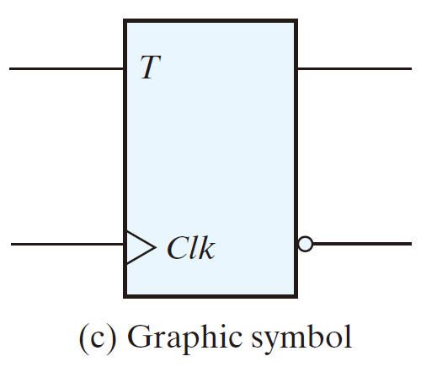
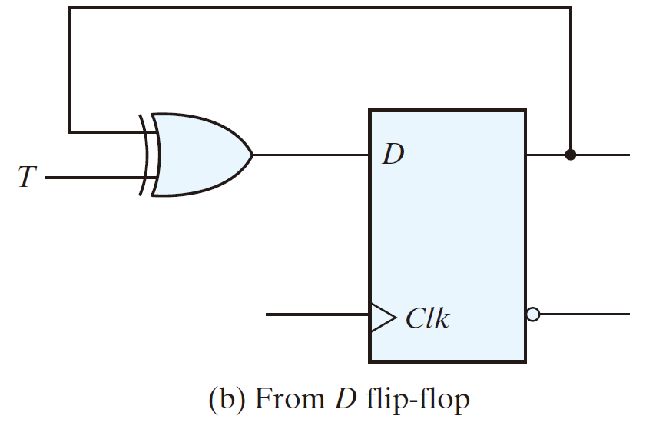
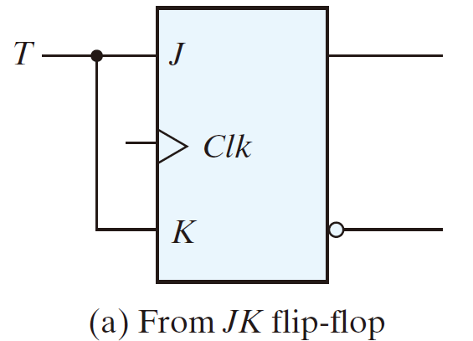
T flip-flop

Slide 162
T flip-flop
  D = T ⊕ Q = TQ‘ + T‘Q
    T = 0: D = Q, no change
    T = 1: D = Q’ → Q = Q‘
J-K flip-flop
    J = 0, K = 0: D = Q, no change
    J = 0, K = 1: D = 0 → Q = 0
    J = 1, K = 0: D = 1 → Q = 1
    J = 1, K = 1: D = Q’ → Q = Q’

Slide 163
T flip-flop
  D = T ⊕ Q = TQ‘ + T‘Q
    T = 0: D = Q, no change
    T = 1: D = Q’ → Q = Q‘

Slide 164
T flip-flop
  D = T ⊕ Q = TQ‘ + T‘Q
    T = 0: D = Q, no change
    T = 1: D = Q’ → Q = Q‘
0

Slide 165
T flip-flop
  D = T ⊕ Q = TQ‘ + T‘Q
    T = 0: D = Q, no change
    T = 1: D = Q’ → Q = Q‘
Q
0

Slide 166
T flip-flop
  D = T ⊕ Q = TQ‘ + T‘Q
    T = 0: D = Q, no change
    T = 1: D = Q’ → Q = Q‘
Q
Q
0

Slide 167
T flip-flop
  D = T ⊕ Q = TQ‘ + T‘Q
    T = 0: D = Q, no change
    T = 1: D = Q’ → Q = Q‘
1

Slide 168
T flip-flop
  D = T ⊕ Q = TQ‘ + T‘Q
    T = 0: D = Q, no change
    T = 1: D = Q’ → Q = Q‘
Q’
1

Slide 169
T flip-flop
  D = T ⊕ Q = TQ‘ + T‘Q
    T = 0: D = Q, no change
    T = 1: D = Q’ → Q = Q‘
Q’
Q’
1

Slide 170
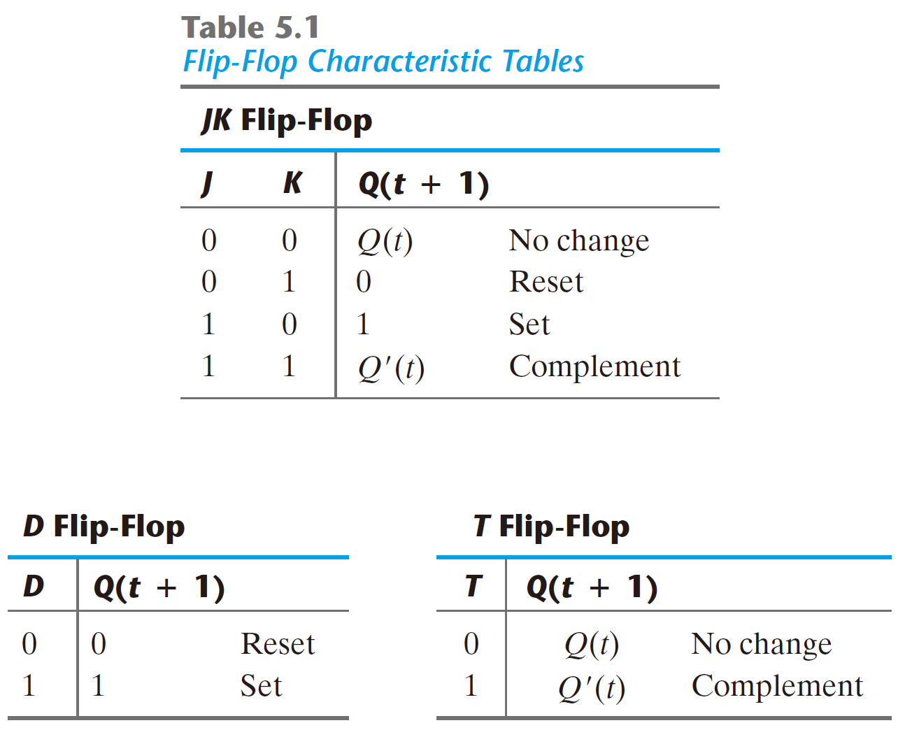
Characteristic Tables

Slide 171
Characteristic Equations
    Q(t + 1) = JQ‘ + K‘Q

Slide 172
Characteristic Equations
    Q(t + 1) = 0Q‘ + 0‘Q = Q
    Q(t + 1) = 0Q‘ + 1‘Q = 0
    Q(t + 1) = 1Q‘ + 0‘Q = 1
    Q(t + 1) = 1Q‘ + 1‘Q = Q’
    Q(t + 1) = JQ‘ + K‘Q

Slide 173
Characteristic Tables
    Q(t + 1) = D

Slide 174
Characteristic Tables
    Q(t + 1) = T⊕Q

Slide 175
Characteristic Tables
    Q(t + 1) = T⊕Q
    Q(t + 1) = 0⊕Q = Q
    Q(t + 1) = 1⊕Q = Q’

